Slide 1

Industry 4.0/5.0
Balamurugan Balakreshnan (Bala)
Cloud Solution Architect – Data and AI
Digital Manufacturing

Slide 2

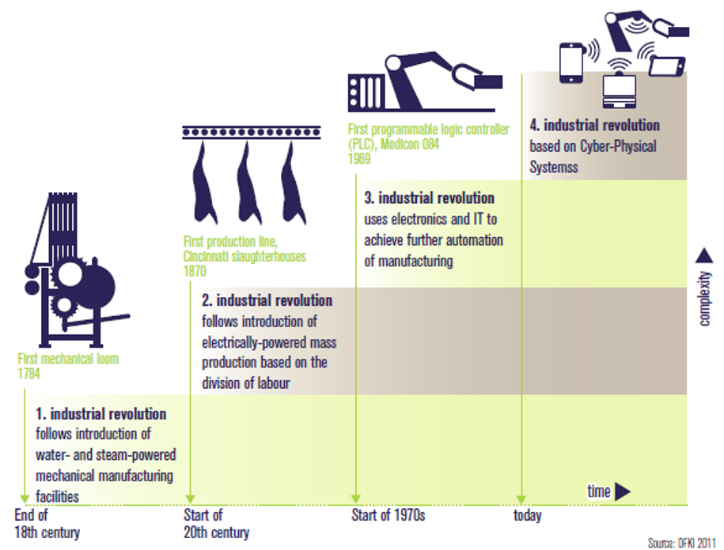
Industry 4.0
Industry 4.0 is a project in the high-tech strategy of the German government, which promotes the computerization of traditional industries such as manufacturing.
The goal is the intelligent factory (Smart Factory), which is characterized by adaptability, resource efficiency and ergonomics as well as the integration of customers and business partners in business and value processes.
Technological basis are cyber-physical systems (CPS) and the Internet of Things.
Source: http://en.wikipedia.org/wiki/Industry_4.0
Source: acatech

Slide 3
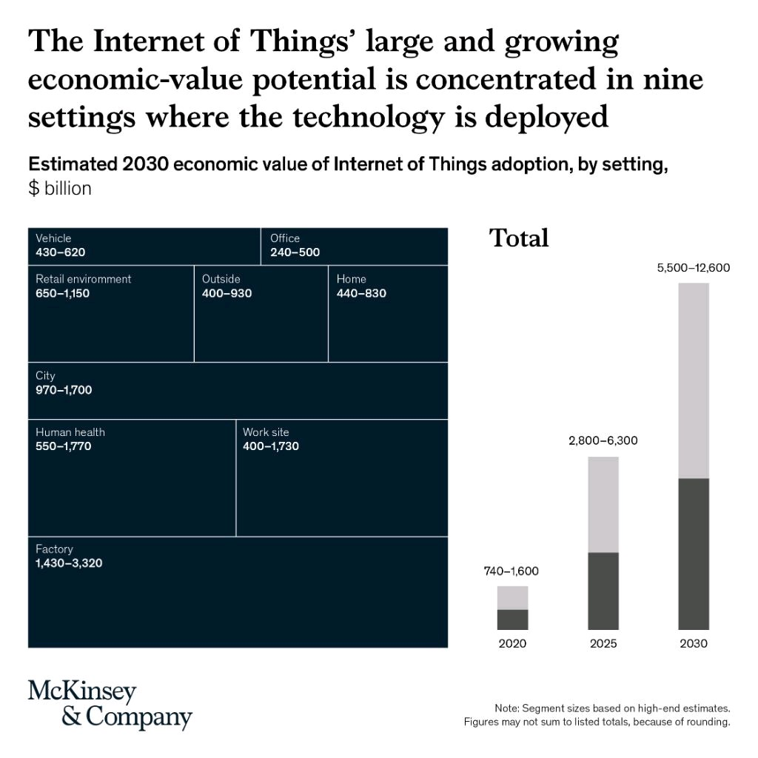

Slide 4
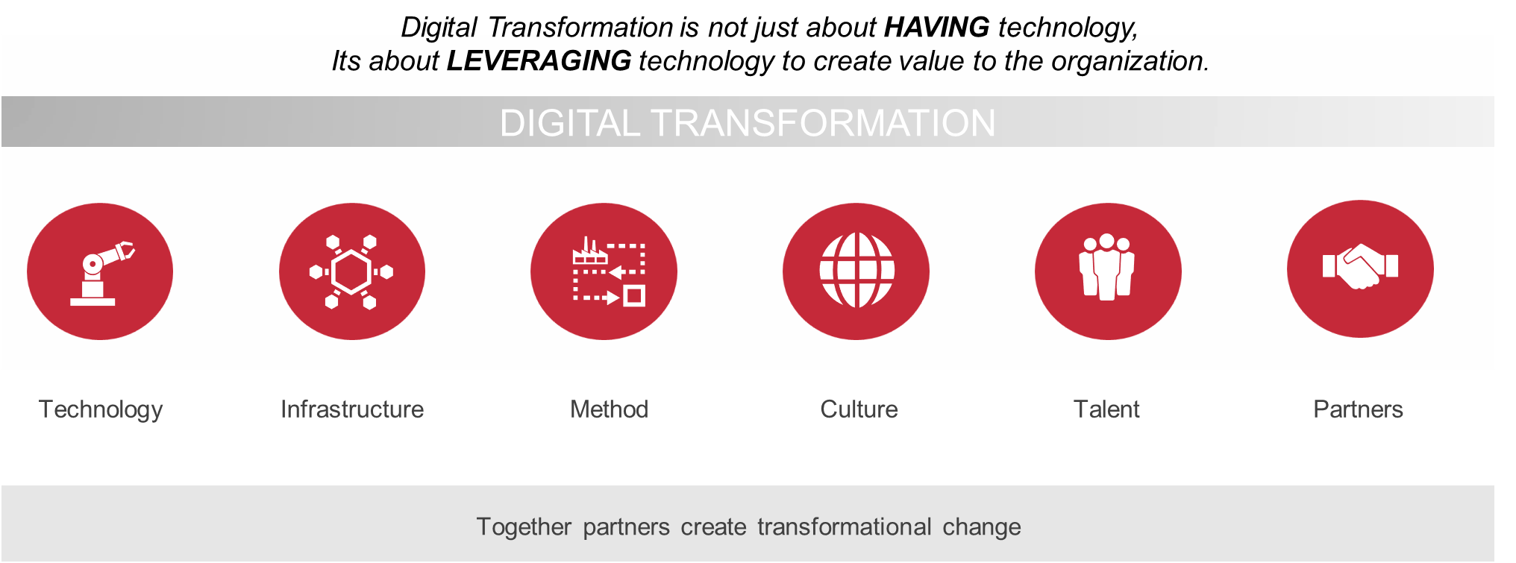
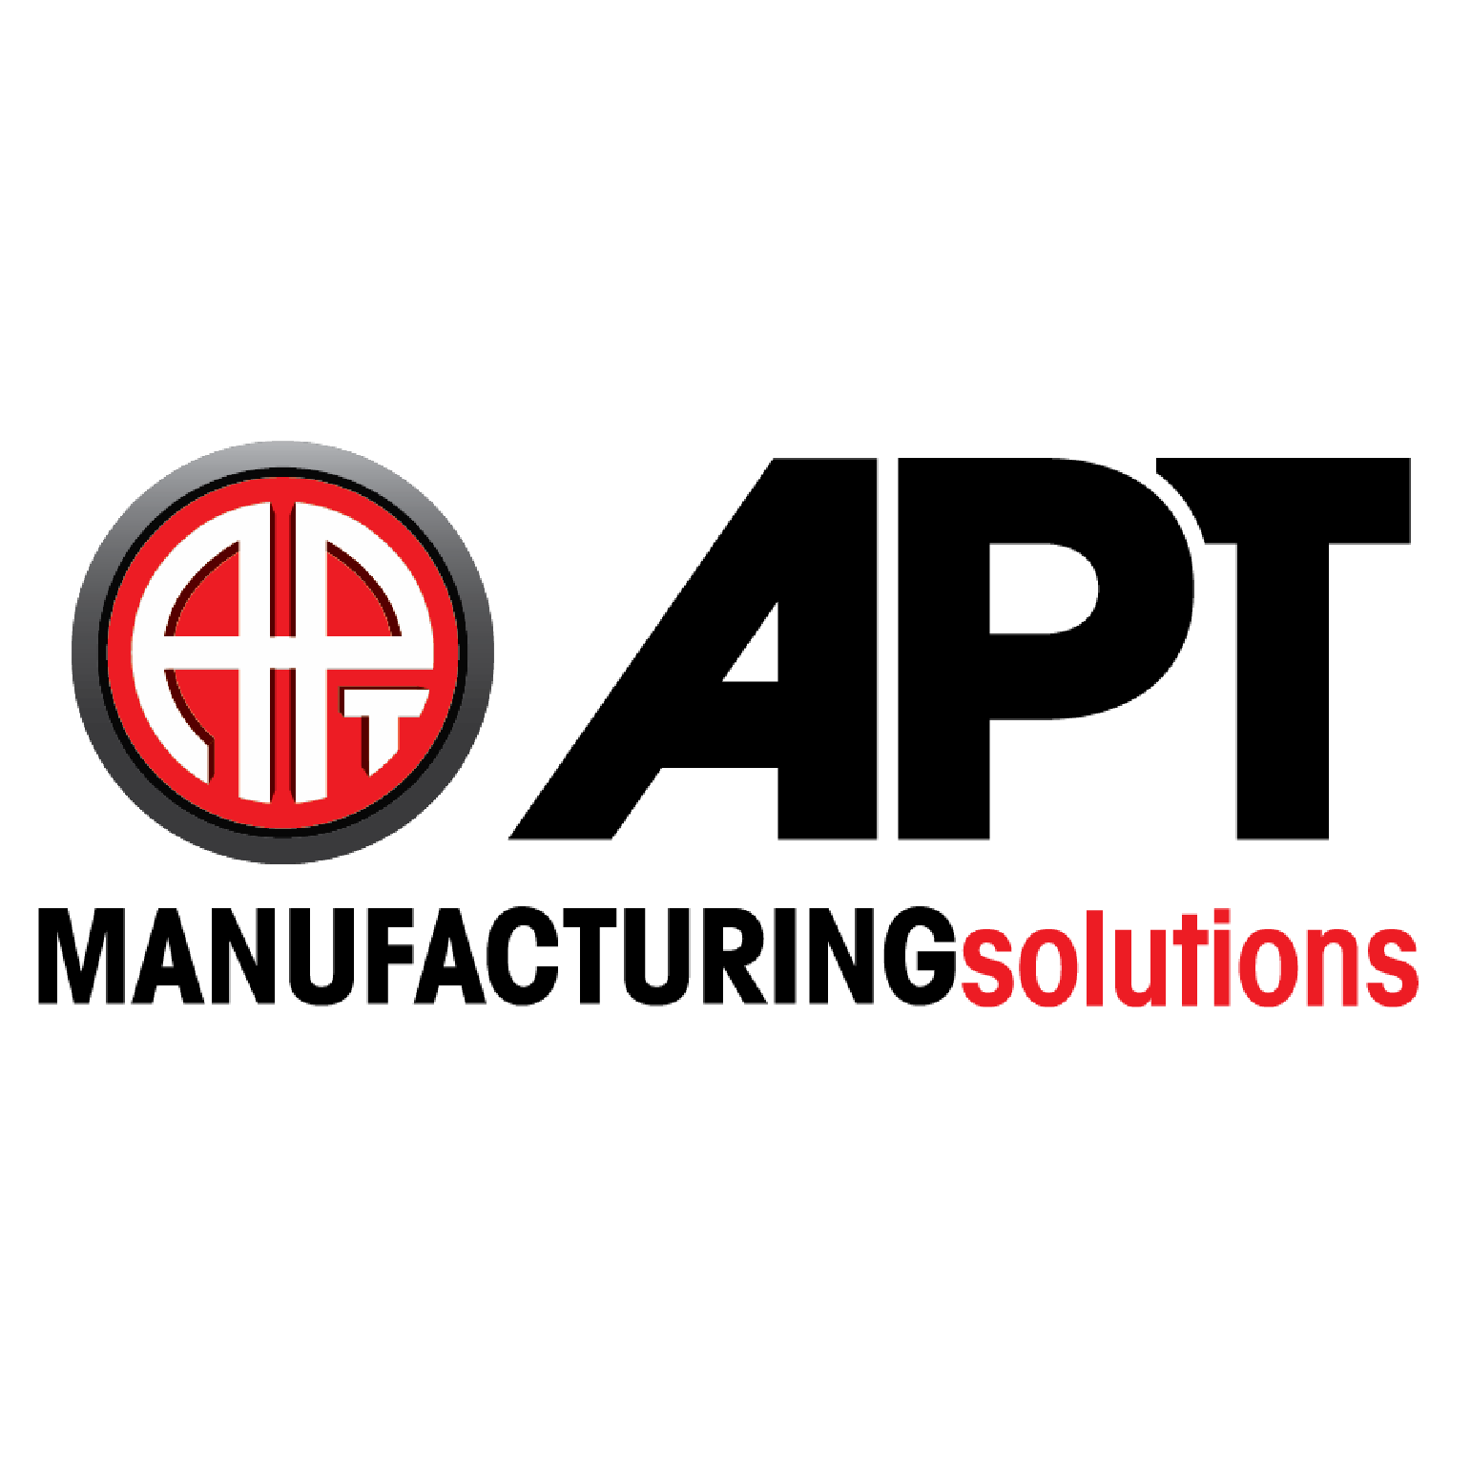

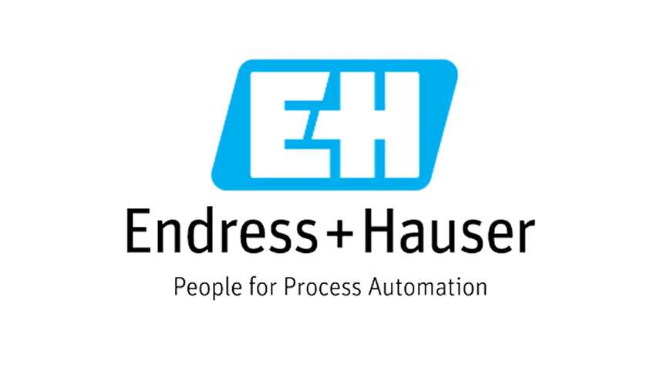

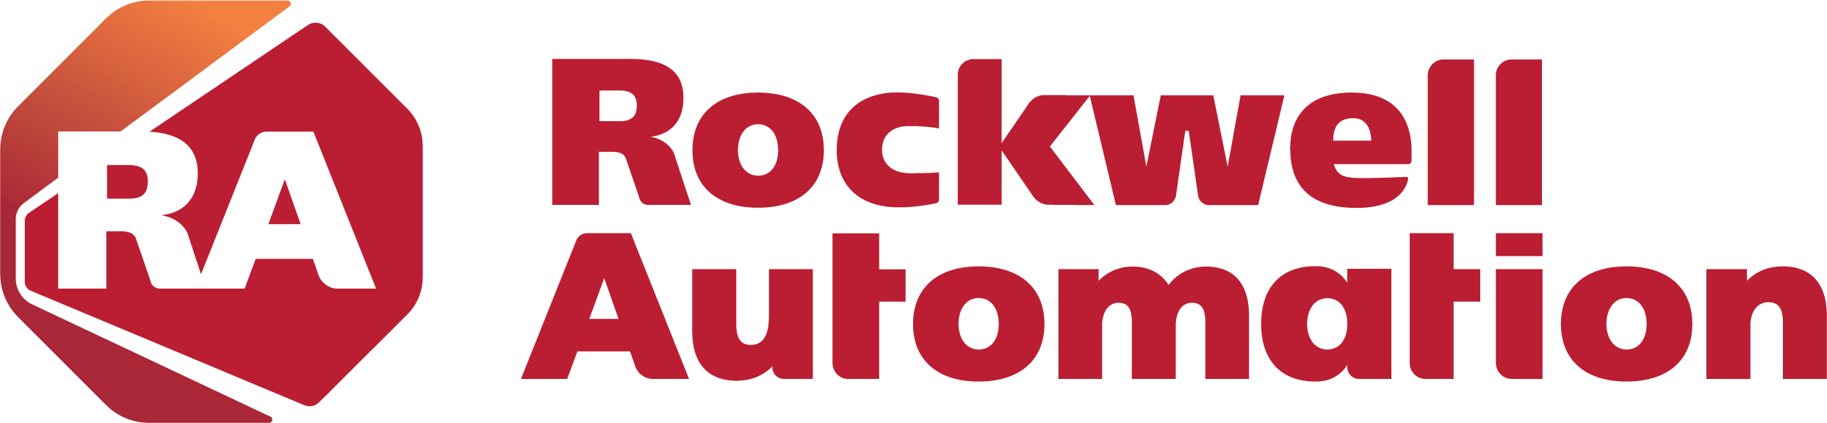


Digital Manufacturing Adoption - Impact
Infrastructure
Talent
Innovation
Adoption
Together partners create transformational change

Slide 5


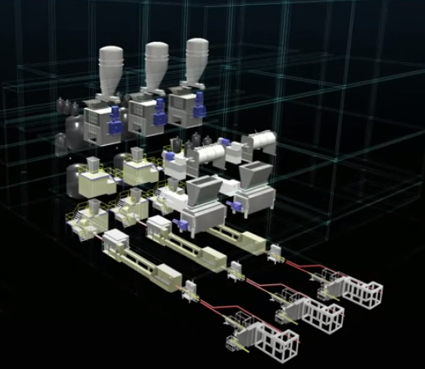
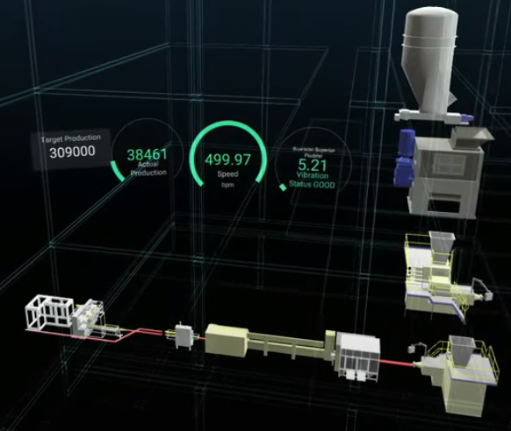
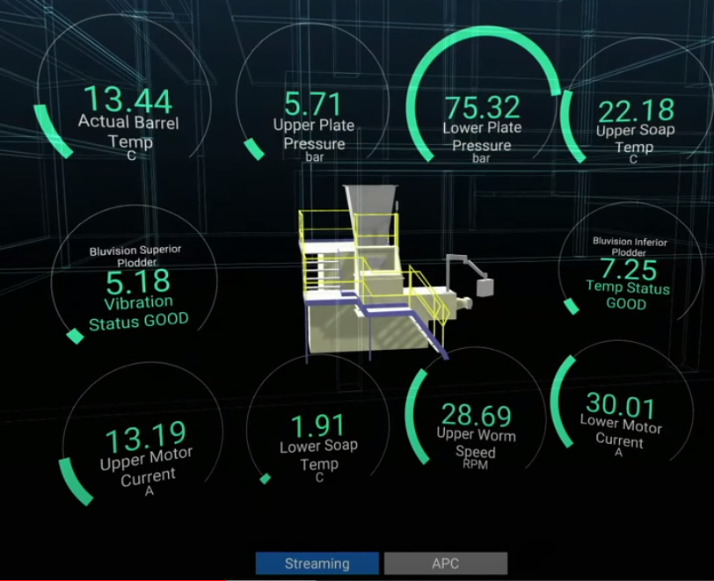
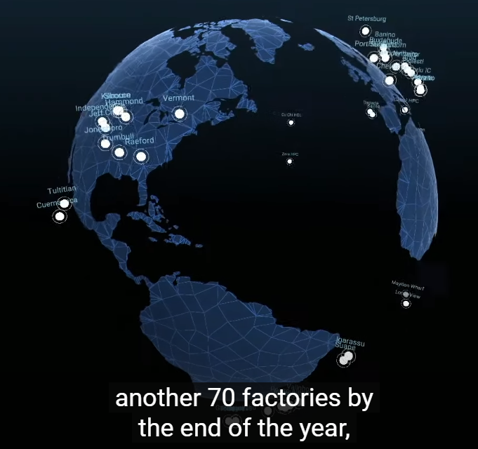
Unilever : Digital Twin in Factories and Supply Chains
3 lines in Valinhos
500 bars soap/min
real-time optimized control
Digital Twin + AI - «2,5 millions euro savings » Unilever, Dave Penrith, Chief Engineer
Soap-making control variable real-time using Advanced Process Control for optimal consistency in « soap-making » operators don’t want to switch if off anymore !

Slide 6


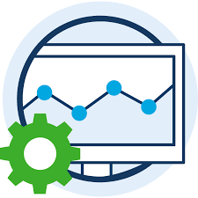

Industrial IoT Data Pipeline
TAKE ACTION
Perform manual or automatic adjustments
To recipes or production processes
Explore and monitor
Perform operational analysis
Models for learning & predictions
COLLECT
Collect data from different sources
PROCESS
Translate, Normalize,
Contextualize &
Enrich
STORE
Store in different (hot, cold) data stores, optimized for analytics
ANALYZE
Run queries for monitoring
Perform asset-based analysis
Use models for machine learning and make predictions

Slide 7






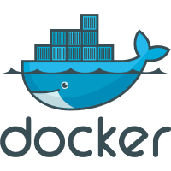



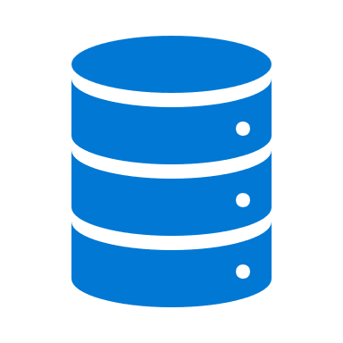





















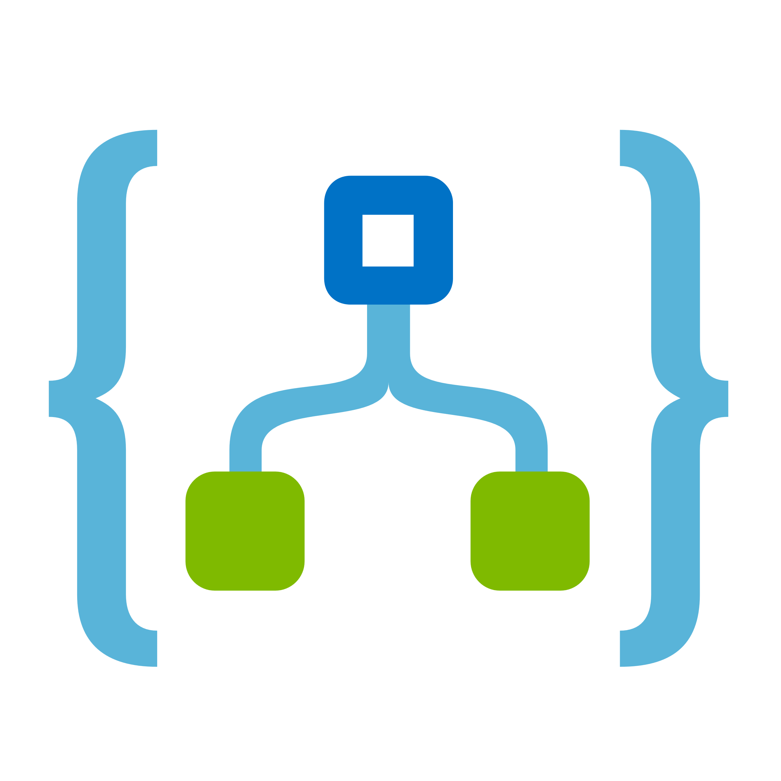


Azure Industrial IoT Reference
Industrial Services
On-Prem
Assets
Protocol & Data Model
Translation
Edge Communication
& Analytics / AI
Azure Cloud
Data Ingestion & Analytics, Command & Control
Azure Cloud
Apps and Business Actions
PLCs,
Databases,
Message Buses,
SCADA Systems,
MES Systems,
ERP Systems
IoT Edge Docker Container Runtime
OPC Twin & Publisher
Azure Digital Twins
Hot/Warm Path Analytics - Stream Analytics, Time Series Data Store / Azure Data Explorer
Custom applications,
dashboards, OEE,
User apps, …
Method calls
Telemetry
Event Hub
Kubernetes/Container Instances ML Inferencing
IoT Hub
Cold Path Analytics
Databricks, Machine Learning, Functions
Connectivity Adapters
from Edge Marketplace
Computer
Vision
/ ML modules
Time Series Exploration
Azure Machine Learning
Model Training
Prop.
Protocol
Long-Term Storage
Data Lake Storage Gen2
Power BI
Local storage & processing modules
Local storage & processing modules
Device
Provisioning
Service
DevOps / ML Ops
Container Registry
Dynamics 365
Deploy new trained models/containers to Edge
Data Factory
Business integration/Logic Apps
Bulk Upload

Slide 8
Academia is Transforming
Strategic shift towards “Workforce of the Future” collaboration with Industry
Data informed academic Investment and economic impact models
Skills more aligned with Industry needs/projections
Flexible educational models- school, 2–4-year degrees, certifications and upskilling
Policy Shift towards execution - state, regional , national workforce of the future for manufacturing competitiveness
Scale to meet Industry skills demand
Supply chain resilience
DOD/DOE/DOL, NMII’s, Made in China 2025, EU, UK Innovate and Catapult network. 4IR,Ind 4.0…….
Incentives-Act 59 in Wisconsin-$1,000/school/student/industry credential.
Technology interoperability , but lagging ind 4.0 applied workforce standards
creating space for thought leaders/marketeers
New and emerging occupations
Cybersecurity an immediate priority and then other key Ind 4.0 pillars –AI,ML, Data, cloud compute, AR

Slide 9
Empower Students with skills needed for today and future
Microsoft
Partners
Rockwell
PTC
Ansys and others
UW Milwaukee
Notes:
CDO wants to setup a centralized organization to manage and create data assets-based business for future. This also emphasis on Self service BI, Data driven Decision making and Advanced analytics like Machine learning or Artificial Intelligence
Self service BI
Data Driven decision making
Machine learning/AI based Insights
Data asset-based revenue – internal and external
Becoming True intelligent organization
CDO – Chief Digital or Data Officer
CAO – Chief Analytics Officer

Slide 10
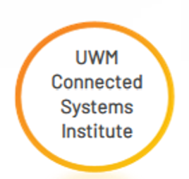
Academic Engagement-COE Pillars
Bridge between Industry and Academic Institutions to proactively build the Future workforce
Access & Sustainability
Thought Leadership & Partnering
Programs & Workforce Standards
Academic Institution Access within co-investment philosophy
COE- share best practices, process and scalable learnings globally.-Diversity, Equity & Inclusion
Internal collaboration for greatest external impact-GSMO, Industry Teams, Corp Strategy
Reference projects-learn from each project and continuously improve with project management for small through complex projects- “proposal to execution” linked to strategy
Microsoft Eco-System engagement with alliance partners, Customer, End Users
Academic Network and eco-system partnering to maximize impact and scalability
Engagement framework for institutions- school, community college, University, Institute –curriculum, facility, process
Industry led workforce development approach to programs-pro-active
Scalable Industry 4.0/Cloud/AI/ML workforce standards and certifications

Slide 11



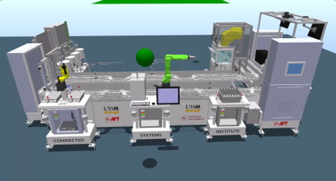
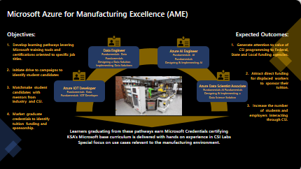
UWM CSI Success
Bridge between Industry and Academic Institutions to proactively build the Future workforce
Education Facility
Skilling Workforce
Partners
Line Built
Data center ready
OT networking
OT/IT connectivity
Cyber Security
MES
Cloud Scale Analytics
Hybrid AI/ML
Industrial Metaverse
Sustainability in MFG
IoT/AI MFG Intro Certs
AI in Business
Digital MFG classes – WEDC funded
AI in MFG
Certification course
IoT Carts
Industrial IoT Carts
University of Wisconsin Milwaukee
Rockwell Automation
PTC
Fanuc
APT
Cisco
Fortinet
Haskell
Endres + Hauser
We Energies

Slide 12

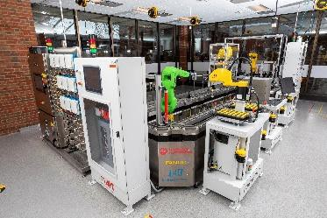
Microsoft Azure for Manufacturing Excellence (AME)
Objectives:
Expected Outcomes:
Develop learning pathways levering Microsoft training tools and certifications oriented to specific job titles.
Generate attention to value of CSI programming to Federal, State and Local funding agencies.
Data Engineer
Fundamentals Data Fundamentals
Designing a Data Solution
Implementing Data Solutions
Azure AI Engineer
Fundamentals AI Fundamentals
Designing & Implementing AI
Initiate drive to campaigns to identify student candidates
Attract direct funding for displaced workers to sponsor their tuition.
Matchmake student candidates with mentors from industry and CSI.
Azure IOT Developer
Fundamentals Data Fundamentals IOT Developer
Azure Data Scientist Associate
Fundamentals AI Fundamentals
Designing & Implementing a
Data Science Solution
Increase the number of students and employers interacting through CSI.
Market graduate credentials to identify tuition funding and sponsorship.
Learners graduating from these pathways earn Microsoft Credentials certifying KSA’s Microsoft base curriculum is delivered with hands on experience in CSI Labs
Special focus on use cases relevant to the manufacturing environment.
Notes:
CDO wants to setup a centralized organization to manage and create data assets-based business for future. This also emphasis on Self service BI, Data driven Decision making and Advanced analytics like Machine learning or Artificial Intelligence
Self service BI
Data Driven decision making
Machine learning/AI based Insights
Data asset-based revenue – internal and external
Becoming True intelligent organization
CDO – Chief Digital or Data Officer
CAO – Chief Analytics Officer

Slide 13
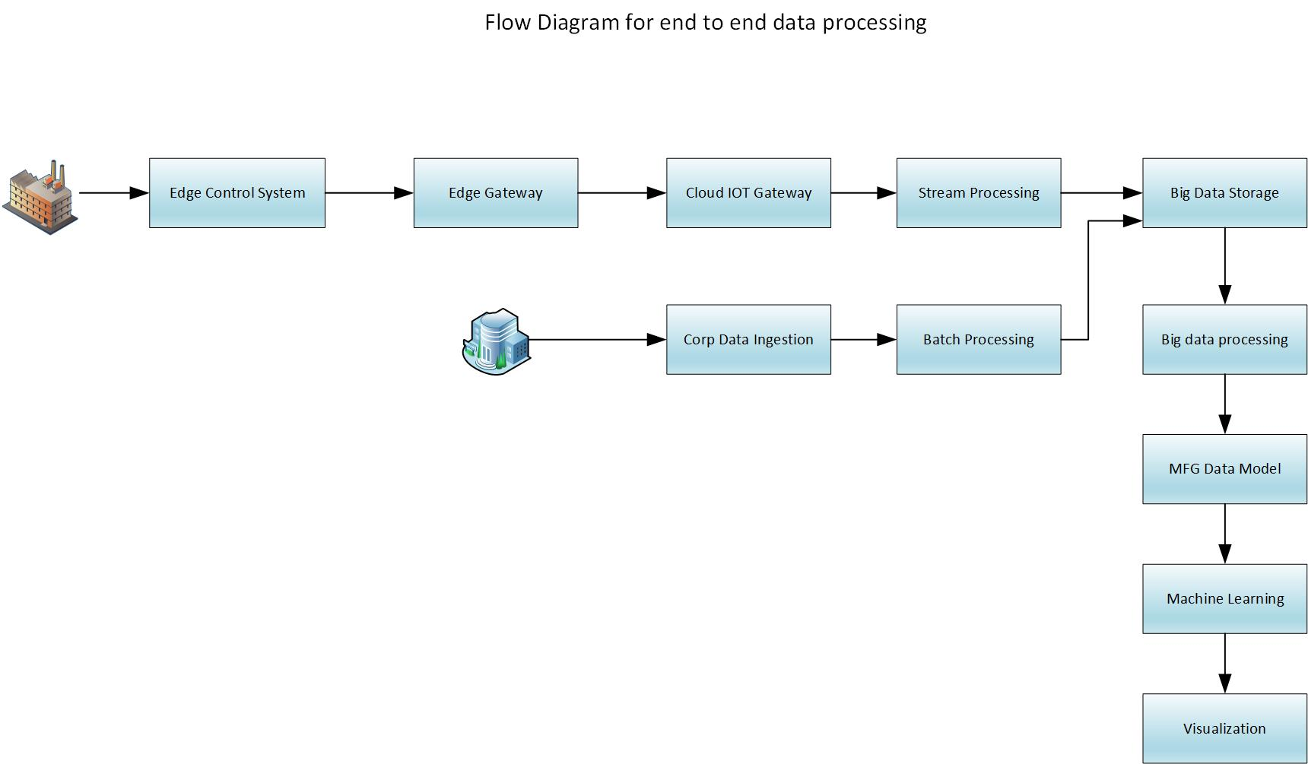
CSI Factory of Future - Cloud

Slide 14
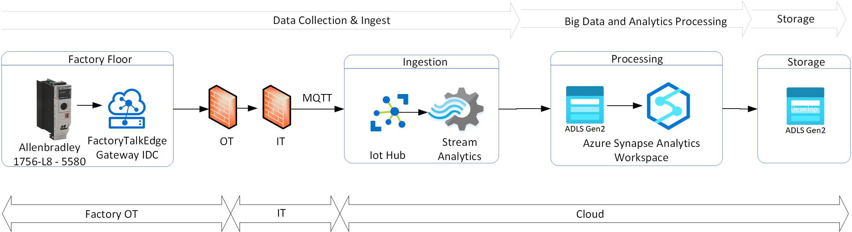
Cloud Architecture for CSI Test Bed – Factory IT/OT connectivity

Slide 15
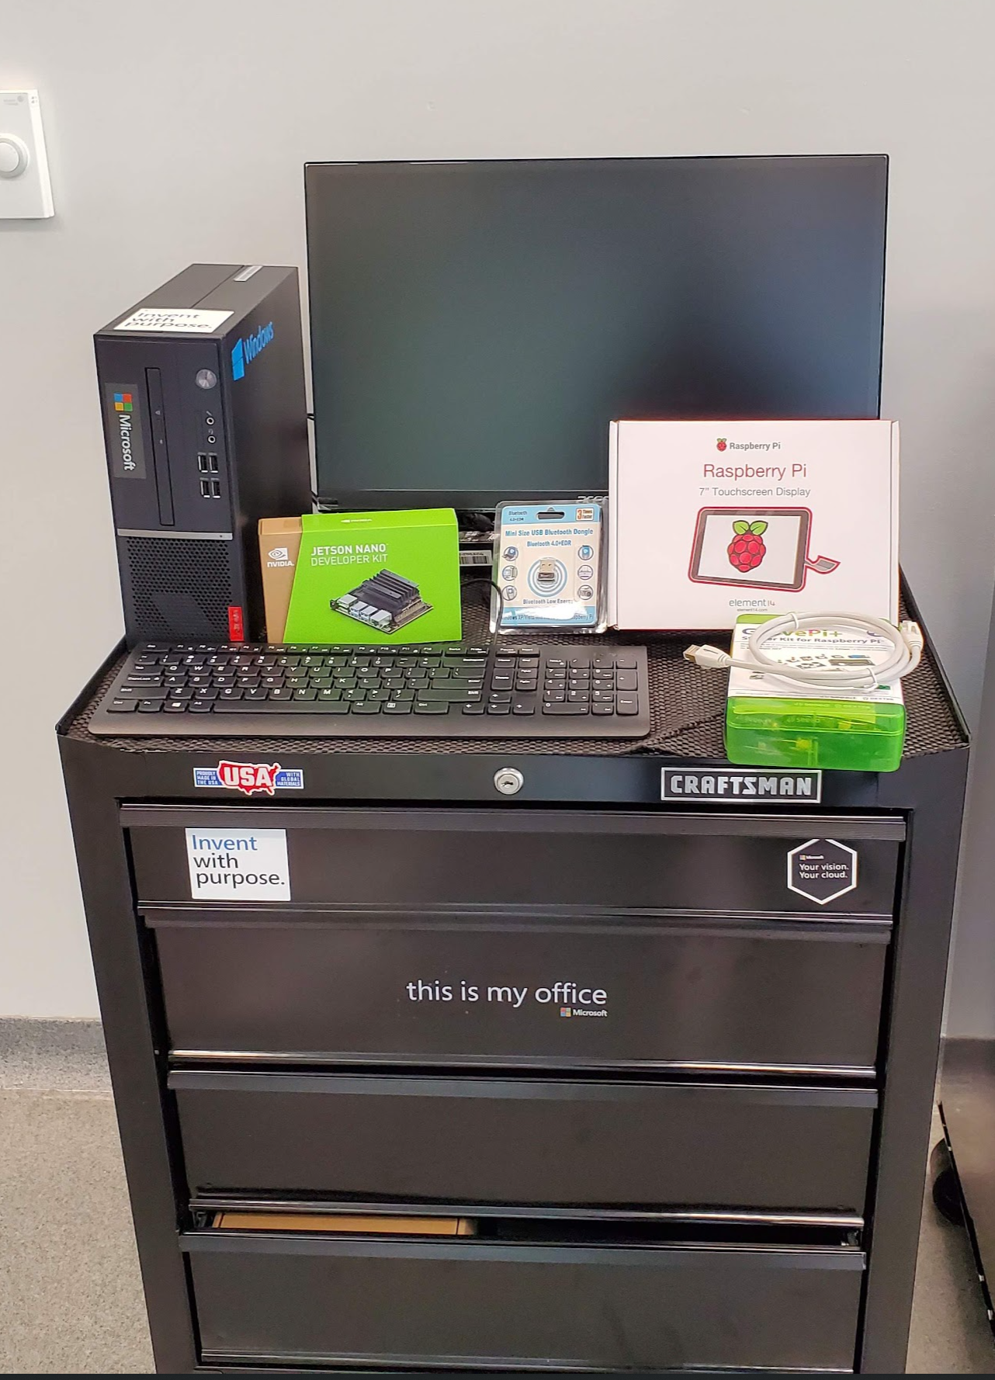
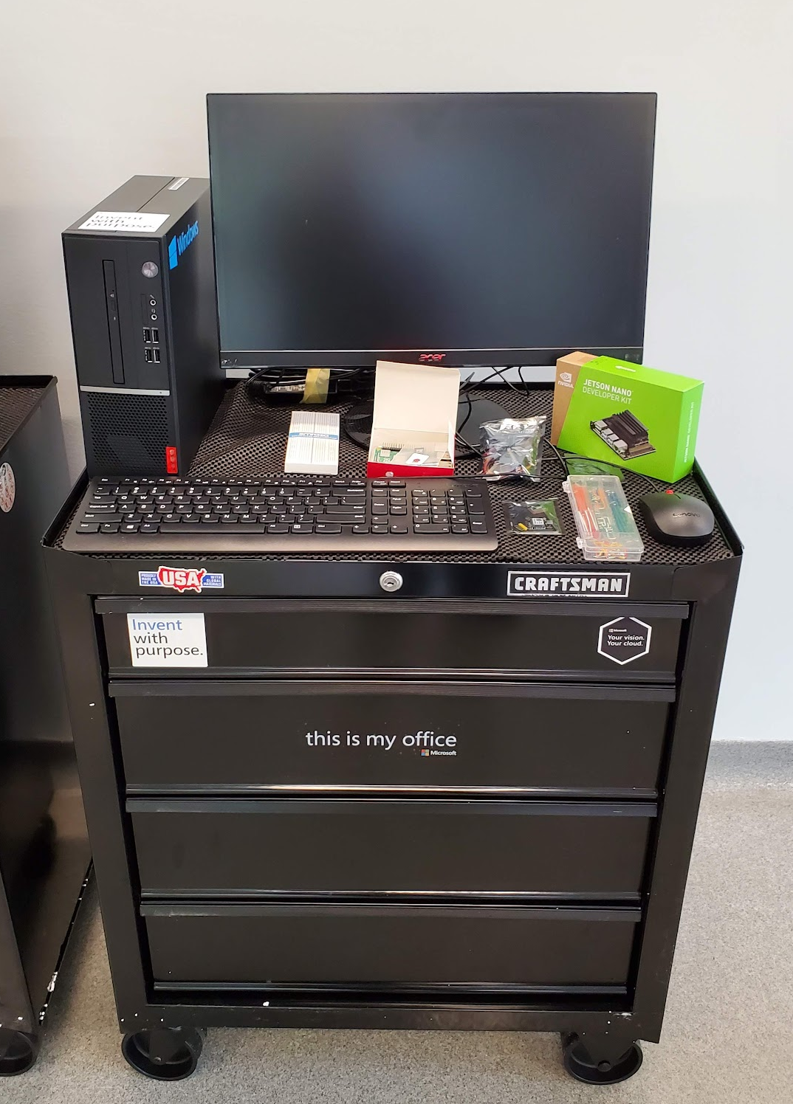
IoT Cart for Students
Link

Slide 16
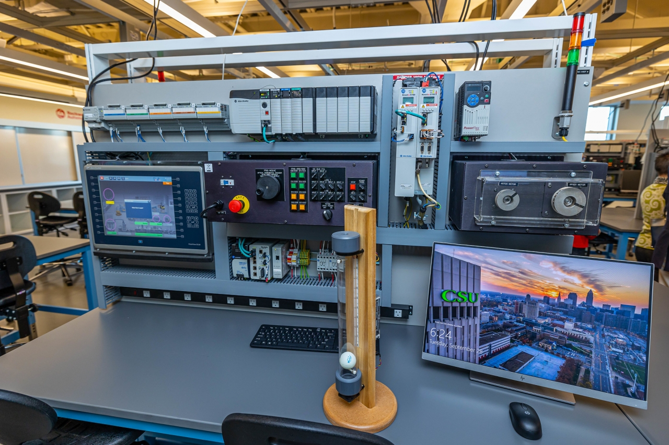
Industrial IoT Cart

Slide 17
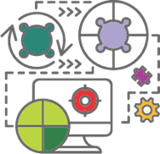
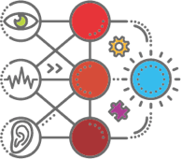
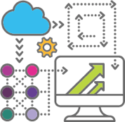
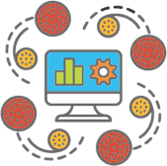


Machine Learning and AI addresses a range of scenarios
High-yield use cases that transform Manufacturing
Quality
Assurance
Demand Forecasting
Production
Scheduling
Anomaly Detection
Predictive
Maintenance
Supply Chain and Inventory Optimization
What are the root causes of recurring problems?
(so I can redesign product, process, training)
What sales or usage volume can I expect?
(so I can optimize my staffing and asset utilization)
What factories, lines, teams, machines, people…are most effective ?
(so I can identify best practices and allocate resources)
What machines are not performing properly?
(so I can immediately investigate)
What is the likelihood this part/machine will fail?
(so I can prevent it from happening)
What is right level and supplier for a part?
(so I can simplify and optimize procurement)
Notes:
CDO wants to setup a centralized organization to manage and create data assets-based business for future. This also emphasis on Self service BI, Data driven Decision making and Advanced analytics like Machine learning or Artificial Intelligence
Self service BI
Data Driven decision making
Machine learning/AI based Insights
Data asset-based revenue – internal and external
Becoming True intelligent organization
CDO – Chief Digital or Data Officer
CAO – Chief Analytics Officer

Slide 18
Iiot
CSI factory to cloud
Quality vision AI

Slide 19
Academia is Transforming
Strategic shift towards “Workforce of the Future” collaboration with Industry
Data informed academic Investment and economic impact models
Skills more aligned with Industry needs/projections
Flexible educational models- school, 2–4-year degrees, certifications and upskilling
Policy Shift towards execution - state, regional , national workforce of the future for manufacturing competitiveness
Scale to meet Industry skills demand
Supply chain resilience
DOD/DOE/DOL, NMII’s, Made in China 2025, EU, UK Innovate and Catapult network. 4IR,Ind 4.0…….
Incentives-Act 59 in Wisconsin-$1,000/school/student/industry credential.
Technology interoperability , but lagging ind 4.0 applied workforce standards
creating space for thought leaders/marketeers
New and emerging occupations
Cybersecurity an immediate priority and then other key Ind 4.0 pillars –AI,ML, Data, cloud compute, AR
Internal Only – do not share
Notes:
3 areas which can adapt most:
Industry value and relevance of existing curriculum and teaching methods
Integration of disciplines across faculty and new approaches to developing workforce of the future
Agility of learning institutions in line with Industry pace of technology adoption
Methodology and outcomes emphasis with learning- risk assessment and execution

Slide 20

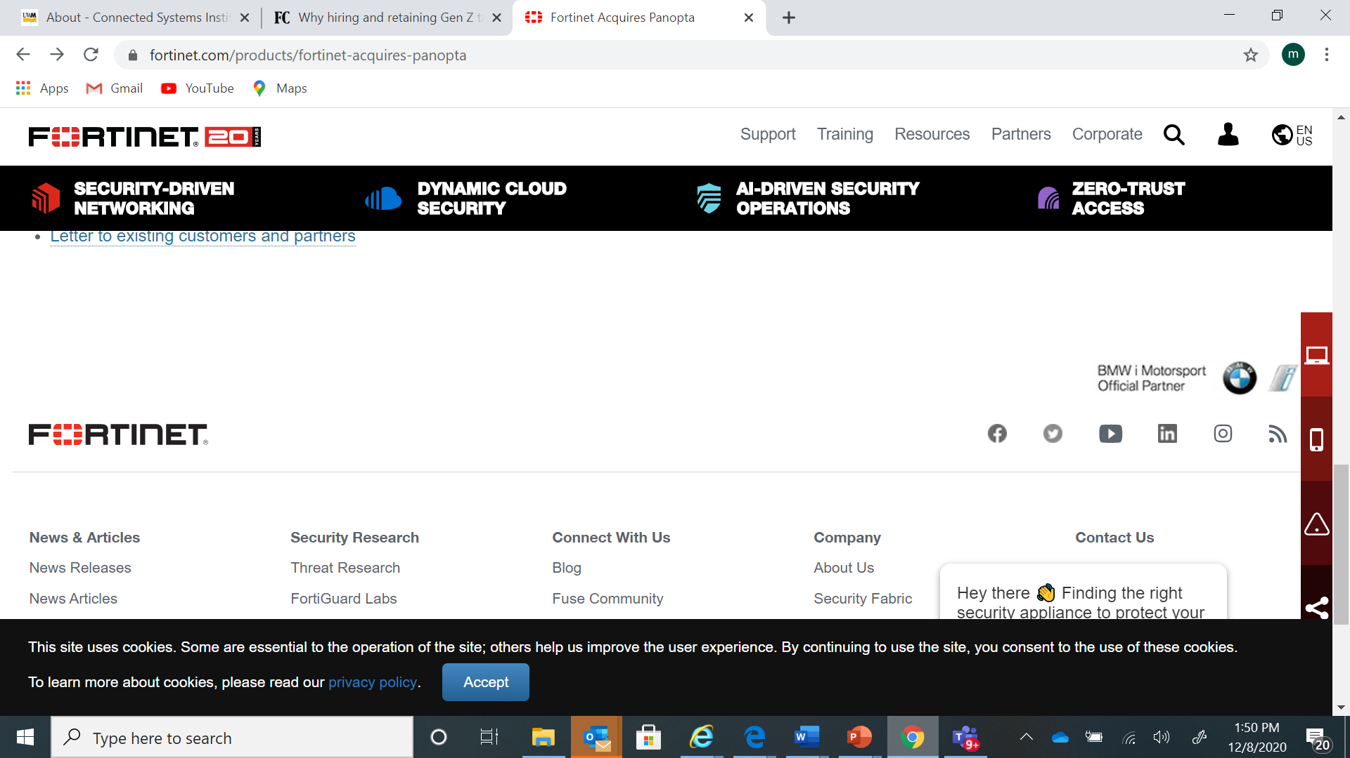



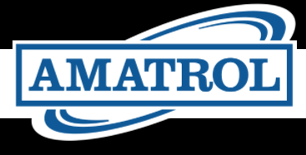
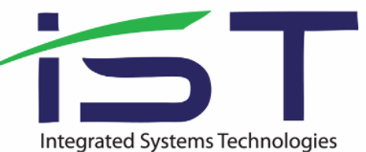
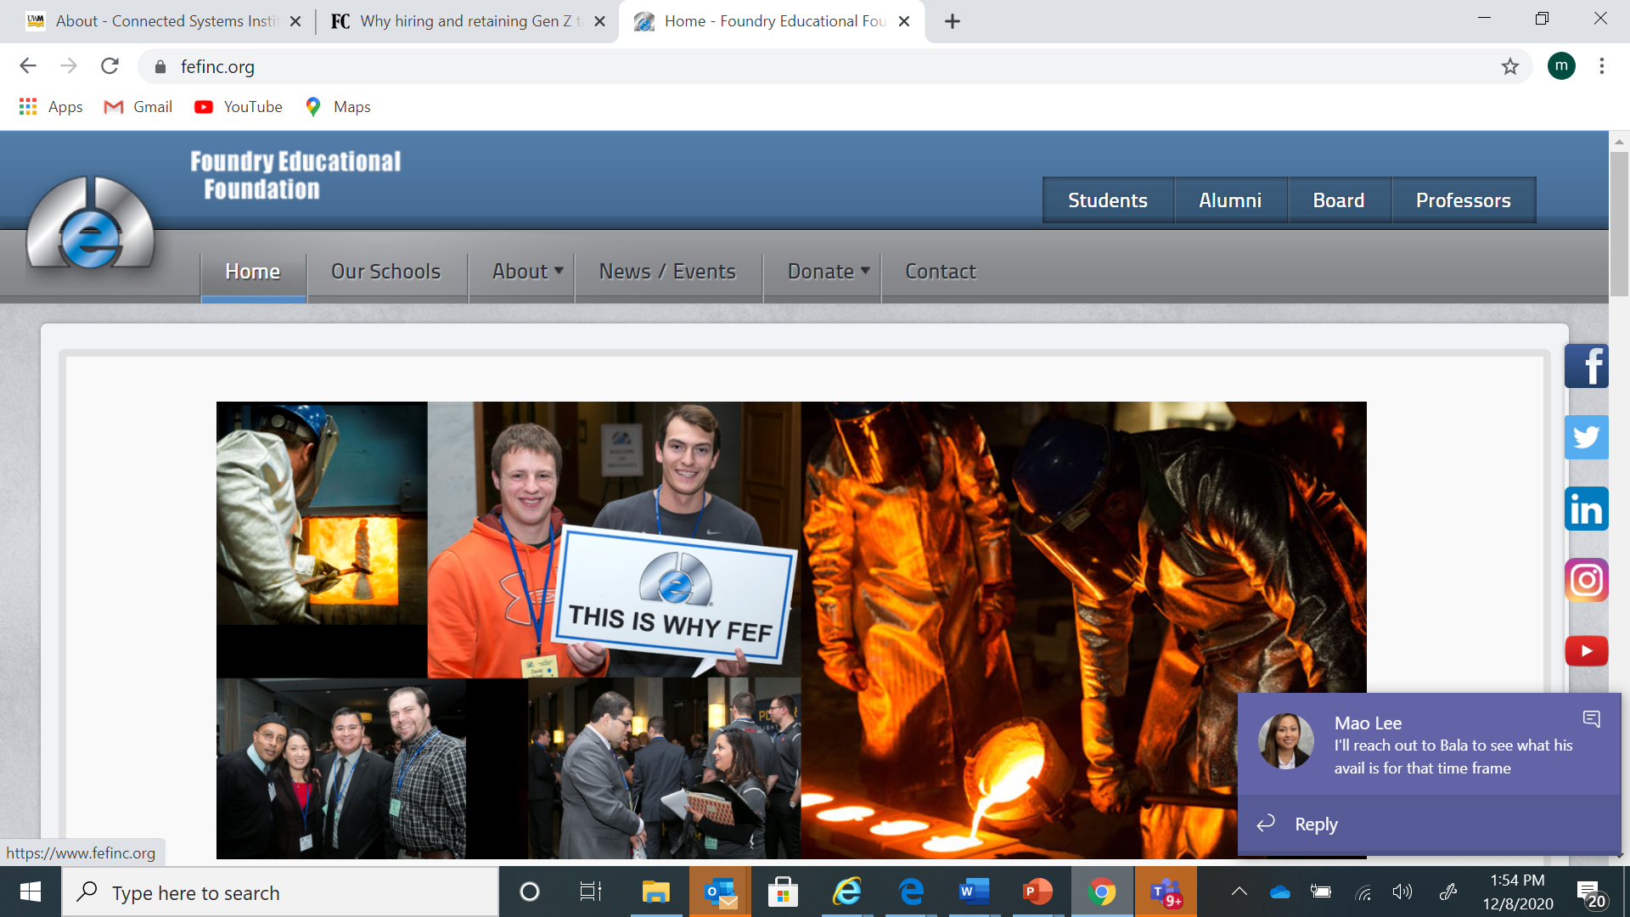
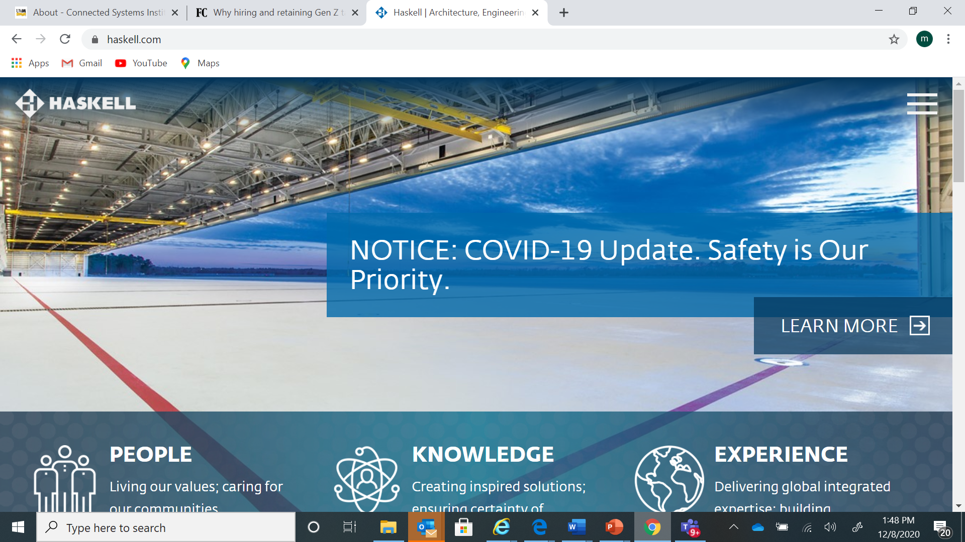


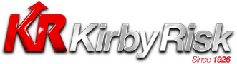

Academia-Industry Eco-System
By combining strengths with stakeholders across government, education, and industry sectors, we address workforce challenges critical to the future growth of manufacturing.
Increased industry relevance:
Infuse industry value and relevance to existing curriculum and teaching methods.
Integration of disciplines:
Provide students an opportunity to learn with integrated technologies and develop multi-disciplinary skill sets.
Increase learning institution responsiveness:
Industry standards allow learning institutions to respond to new technology adoption and prepare students for emerging high demand occupations with tighter links to industry, and sustainable/adaptable learning environments.
Digitalization and Cyber security
Internal Only – do not share
Design, Discrete and Process
Integration, OEMs, Market Access
Representative, examples, not exhaustive

Slide 21
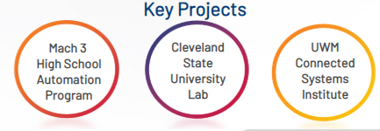
Academic Engagement-COE Pillars
Bridge between Industry and Academic Institutions to proactively build the Future workforce
Access & Sustainability
Thought Leadership & Partnering
Programs & Workforce Standards
Academic Institution Access within co-investment philosophy
COE- share best practices, process and scalable learnings globally.-Diversity, Equity & Inclusion
Internal collaboration for greatest external impact-OGC/HR, GSM, CSM and BU’s
Reference projects-learn from each project and continuously improve with project management for small through complex projects- “proposal to execution” linked to strategy
ROK Eco-system engagement with alliance partners, SI’s, SP’s, end-users, Distributors
Academic Network and eco-system partnering to maximize impact and scalability
Engagement framework for institutions- school, community college, University, Institute –curriculum, facility, process
Industry led workforce development approach to programs-pro-active
Scalable Industry 4.0 workforce standards and certifications
Core consultative team, focused on differentiation, eco-system impact, quality and scale
Internal Only – do not share
Notes:
21

